Slide 1
AlexNet DRAM Access
Matt Liu B06901182 Andrew Wong B06901160

Slide 2
Channel → 2D → Kernel
 | Weight | Input Activation | Partial Sum
Layer0 | 34848 | 927522 | 290400
Layer1 | 7260000 | 4646400 | 665856
Layer2 | 2519424 | 4478976 | 240000
Layer3 | 1327104 | 1557504 | 46464
Layer4 | 1327104 | 1557504 | 30976
Total weight DRAM access: 12468480
Total IF DRAM access: 13167906
Total Psum DRAM access: 1273696
Total DRAM access: 26910082

Slide 3
DRAM Access Chart Log Scale

Slide 4
Channel → Kernel → 2D
 | Weight | Input Activation | Partial Sum
Layer0 | 7014385 | 154587 | 290400
Layer1 | 7260000 | 4646400 | 665856
Layer2 | 2519424 | 4478976 | 240000
Layer3 | 1327104 | 1557504 | 46464
Layer4 | 1327104 | 1557504 | 30976
Total weight DRAM access: 19448017
Total IF DRAM access: 12394971
Total Psum DRAM access: 1273696
Total DRAM access: 33116684

Slide 5
DRAM Access Chart Log Scale

Slide 6
Current & Future Works
Analyze dense mode DRAM access times
16 GB weight SRAM/ 16 GB IF SRAM/ Psum SRAM(?)
Python simulation
Verify dense mode
Simulate sparse mode
2D algorithm
Psum storage

Slide 7
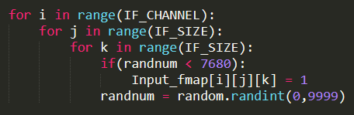
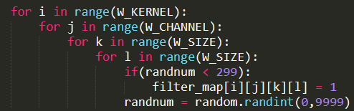
Python simulation
Randomly prune

Slide 8
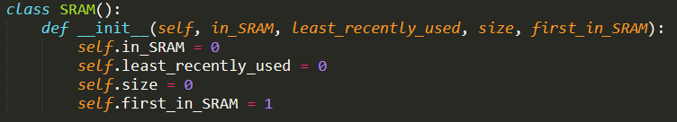
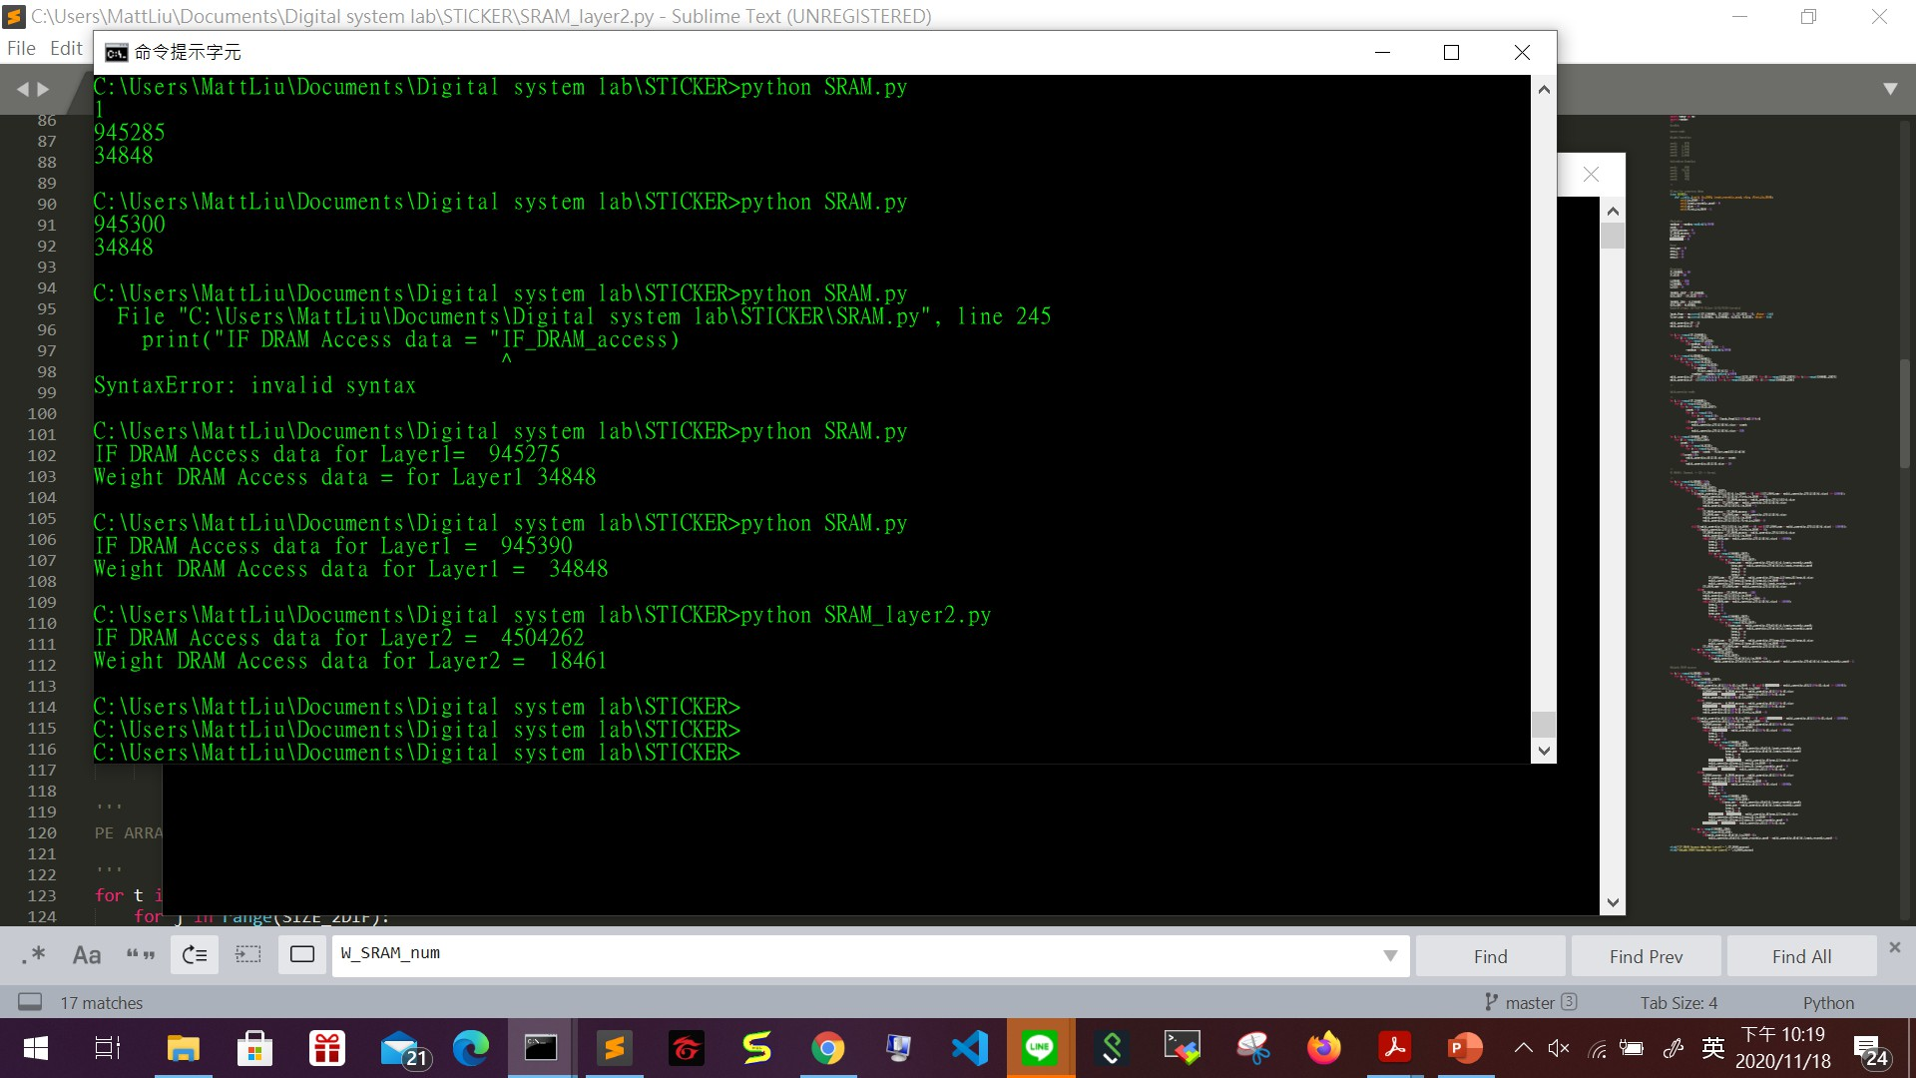
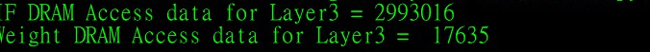
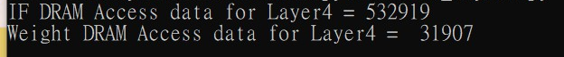
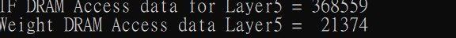
Python Simulation

Slide 9
DRAM_Access_datanum(Sparse)
Total Weight Access = 124225
Total IF Access = 9344146
 | Weight_DRAM_Access | IF_DRAM_Access
Layer0 | 34848 | 945390
Layer1 | 18461 | 4504262
Layer2 | 17635 | 2993016
Layer3 | 31907 | 532919
Layer4 | 21374 | 368559

Slide 10
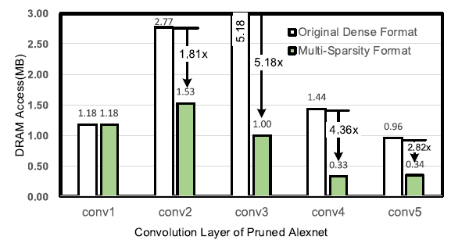
Dense vs Sparse

Slide 11
Future Work
Better algorithm
Merge our data and STIKER’s data

Slide 12
end

